Slide 1


Deep Learning in Vision | Ramon Schildknecht Assignment «Crazy Picture Predictions» | December 2019
Introducing Alexa…
Just kidding ☺
Now the real Alexa…
I am so excited! I will solve several classifying problems like differentiate between sunny and cloudy images, lake and mountains, holiday countries like United States of America and China …

Slide 2
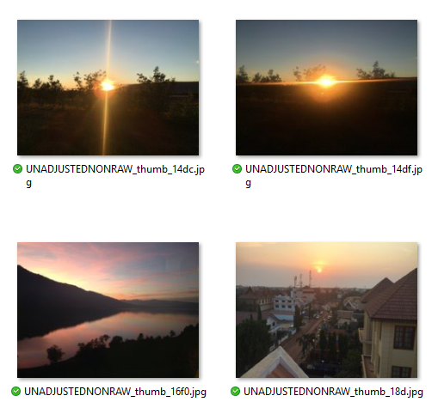
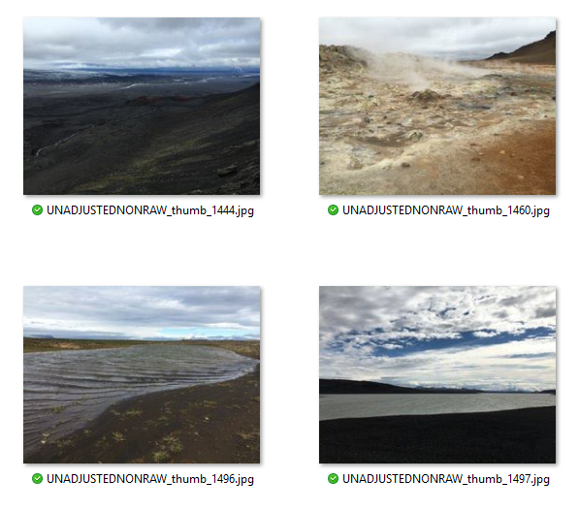
Alexa starts with sunny vs. cloudy images
Images: tag filtered pictures from Ramon’s personal iPhotos (Apple). Tags: «sun», «cloudy»

Slide 3
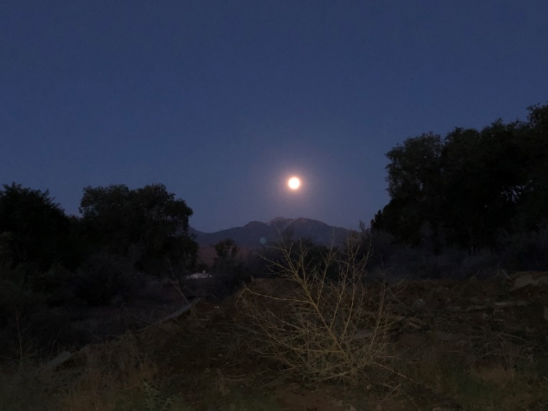
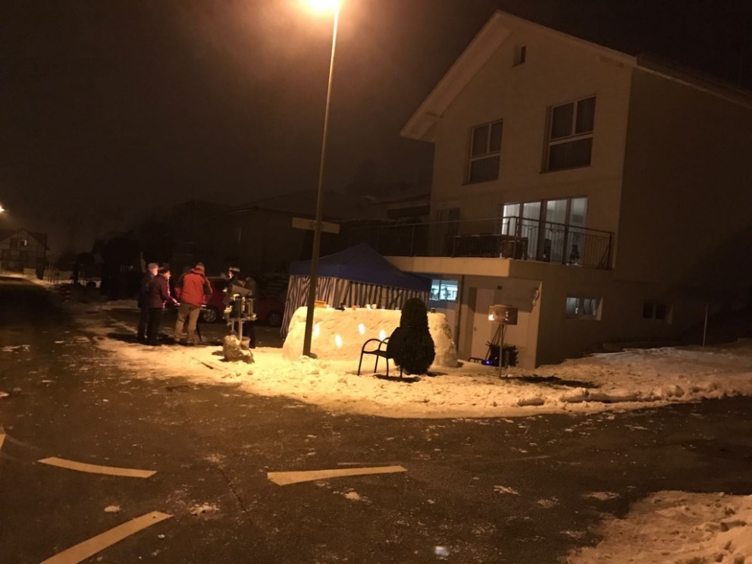

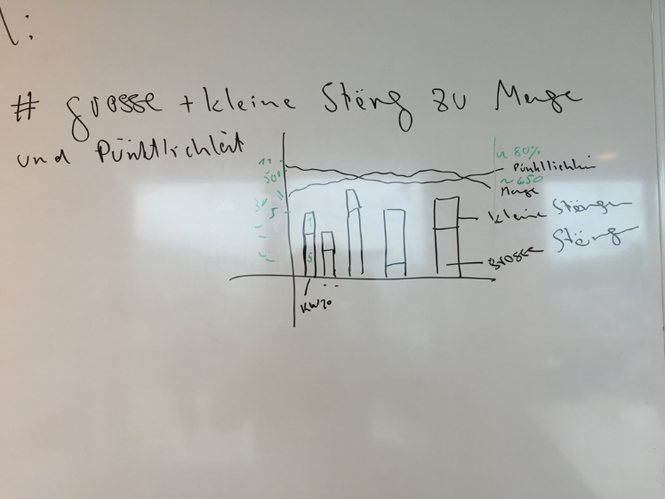

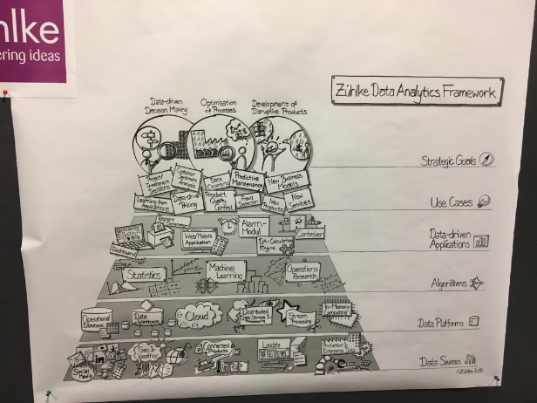
Apple, let’s talk about data quality!
Why is that sunny?
Why is that cloudy?

Slide 4
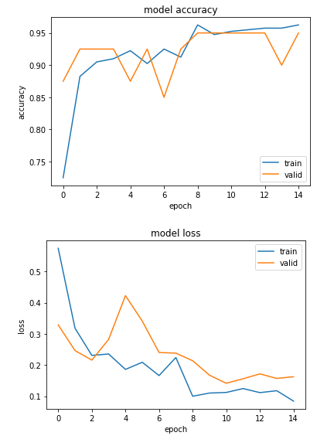
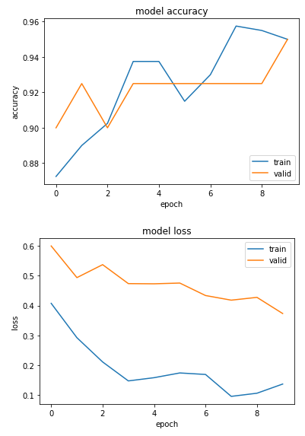
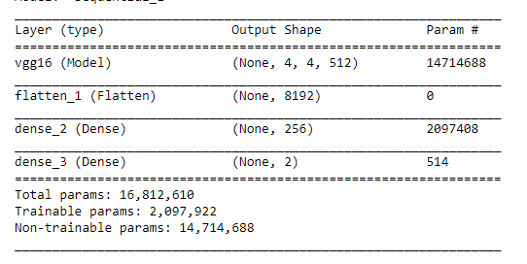
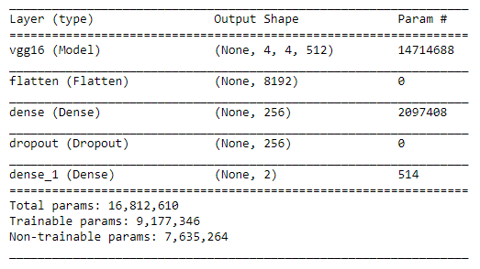
Alexa tried really hard, see what she found out…
Data preparation:
Train: 440 pics = 226 cloudy + 174 sun
Validation: 40 pics = 22 cloudy + 18 sun
HIGHLIGHT MODELL «HAPPY» | Transfer Learning | ~16’ runtime |
batch size = 20 | 15 epochs
AWESOME MODELL «PRETTY LUCKY» | Fine Tuning VGG16 | ~12’ runtime |
batch size = 40 | 10 epochs
loss: 0.0843 | acc: 0.9625
val_loss: 0.1624 | val_acc: 0.9500
loss: 0.1372 | acc: 0.9500
val_loss: 0.3734 | val_acc: 0.9500
Details → Check Jupyter Notebook «4.2 2. Approach : Training the model end to end with a frozen convolutional base»
Details → Check Jupyter Notebook «4.3 Fine Tuning»

Slide 5
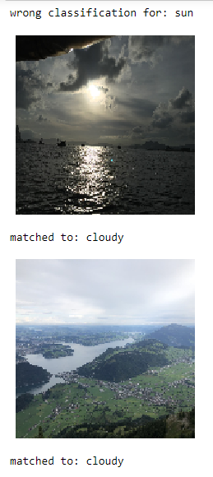
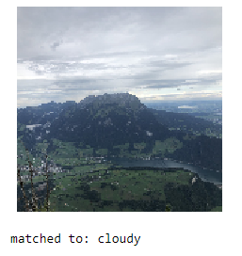
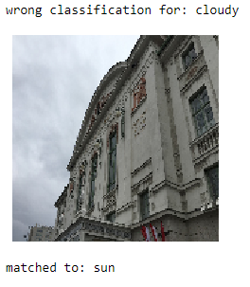
What about the wrong classified pictures [MODELL AWESOME]?
Bottom line: not so wrong after all or → how much sun to
cloud ratio does it need to be tagges as «sun»?
Truly wrong

Slide 6
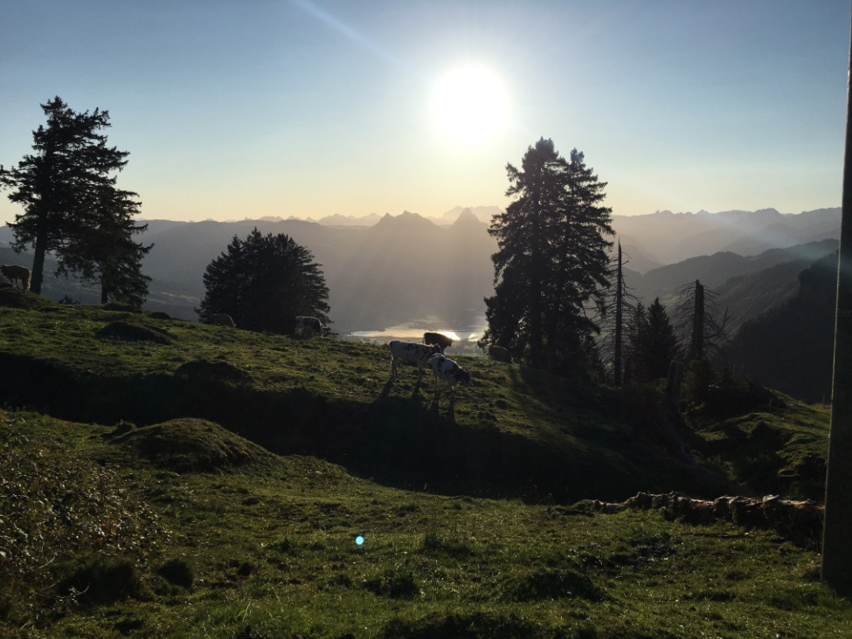
Alexa wonders… what’s about the learning of ConvNets?

Slide 7
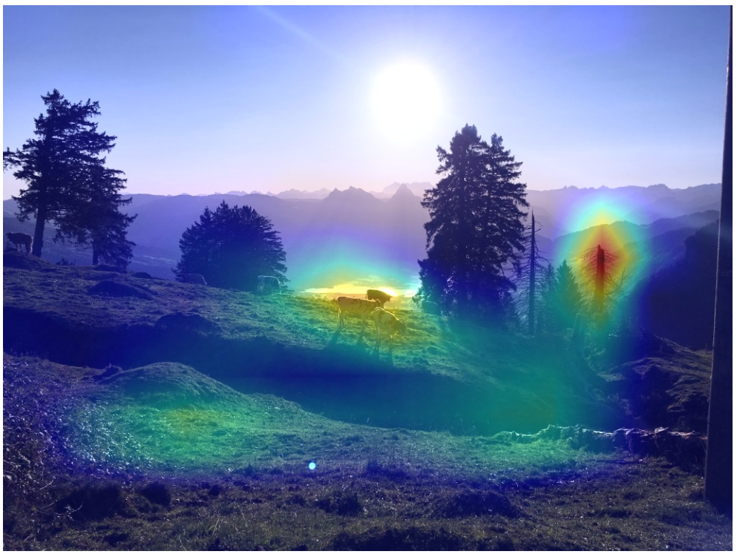
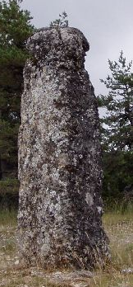
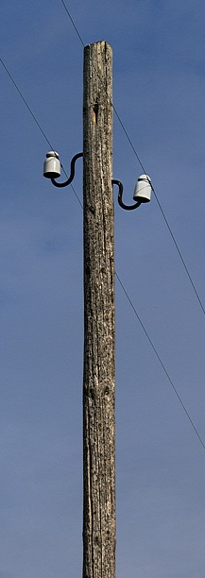
Alexa wonders… what’s about the learning of ConvNets?
Can you guess the predicted class of the VGG16 network?
Alps it is ☺
Its mount Rigi!
sun? really not a winner here…
Rank 42 with P = 0.2%
But 12% probability for megalith and pole as well…

Slide 8
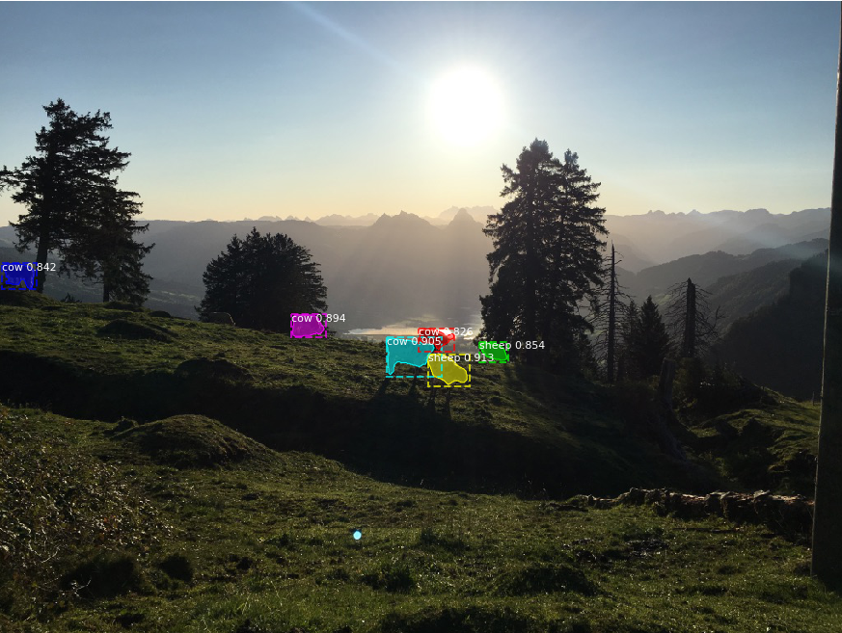
Alexa wonders… what’s about the learning of Mask R-CNNs?
4 of 6 cows predicted correctly (~67%)
To be honest: one sheep in the back
is even for a human hard to tell!

Slide 9
Let’s check about the magic of Mask R-CNNs!
4 of 6 cows predicted correctly (~67%)
To be honest: one sheep in the back
is even for a human hard to tell!

Slide 10
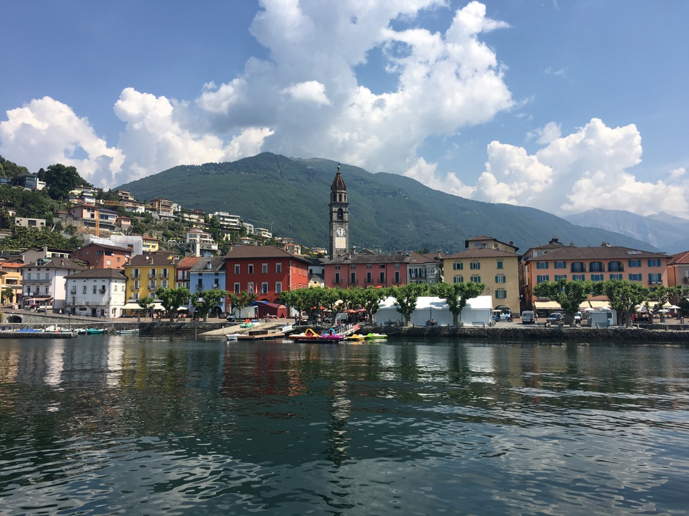

Final check about Mask R-CNNs. Let’s visit Ascona (Ticino)!
What do you guess the COCO algorithm detects (cheat sheet ↓)?

Slide 11
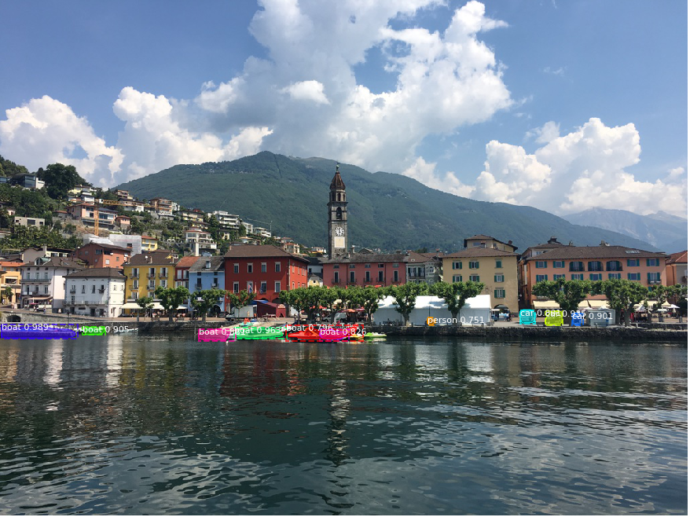



Final check about Mask R-CNNs. Let’s visit Ascona (Ticino)!
Bottom line: quite good results, but there are more
persons and cars in the picture!

Slide 12

Conclusion
Outlook
Quite good results to predict «sun» vs. «cloudy» pictures (val acc: 0.95)
Thesis: Deep learning can improve the prediction quality of the weather in the near future (<= 5 years) → there’s already a lot going on in this field, details can be found here in this example
One use case is already very time consuming, but there are some interesting use cases:
Can I predict the country in which the picture was taken with a model?
Can a model tell which people are my family members based on my own pictures (without labels)?
Can a model tell in which communities I lived without the location information?
I’m truly impressed! I got very helpful insights ☺ It’s a wonderful but very challenging topic 
Thanks for your attention!

